Slide 1
Calories predictions from continuous glucose monitors
Sai Jaideep Reddy Mure

Slide 2
Research Overview and goals
A quick overview of the project:
Data includes CGM data, Viome data, demographic data, and breakfast/lunch intake data.
What if we use different combinations of inputs?
What approaches are suitable for small and complex datasets?
What if we divide calorie estimations into separate tasks and train them individually?
What Happens if the start to freeze of the weights of the network of hidden layers ?

Slide 3
Proposed Diagram
Proposed Architecture
Dense
L
a
Y e r
Dense l
a y e r
Denselayer
Cgm Data
output
Demo data
Img data

Slide 4
Challenges/proposed solutions
Giving equal importance to all inputs
Complexity increases, leading to slower optimization.
Identifying critical data for the output.
Needed to train model for different with not equal importance of data
Previous Solutions Proposed
Using different architectures to combine inputs at various levels
Combining 2 inputs at the y-th hidden layer.
Merging the 3rd input at the x-th hidden layer.

Slide 5
proposed solutions
Solutions Proposed
After Certain epochs we will start to freeze weights till the second input given to the network
After Certain epochs we will start to freeze weights till the 3rd input is given to the network

Slide 6
Methodology
Different Network Approaches
Designed the 3-input model based on data type, ensuring compatibility with various data representations.
Marked an individual order for their respective loss functions to prioritize specific predictions.
Incorporated additional preprocessing steps to enhance feature extraction for each input type.

Slide 7
Methodology
Assigned the highest loss at the beginning and the lowest at the end in the hidden layers.
For CGM data we have used the sliding window to extract features
Optimizer used is adam
Train-validation : 90 10

Slide 8
Methodology
Needed to check on the minimizing variances between batches and balancing weights
- LibAUC: A Deep Learning Library for X-Risk Optimization Paper
changed the optimizer to LibAUC
AUCMLoss is best considered in paper but implemented NRMSRE Loss
Based on the positive samples and the negative samples the loss function is designed.

Slide 9
Methodology
Step1 : For First 5 epochs I have trained all the weights
Step2 : for next 5 epochs I have freezing weights between the first input and second input
Step3 : for next 5 epochs I have freezing weights between the second input and 3rd input
Step 4 : After this I have trained all weights early stopping triggered.

Slide 10
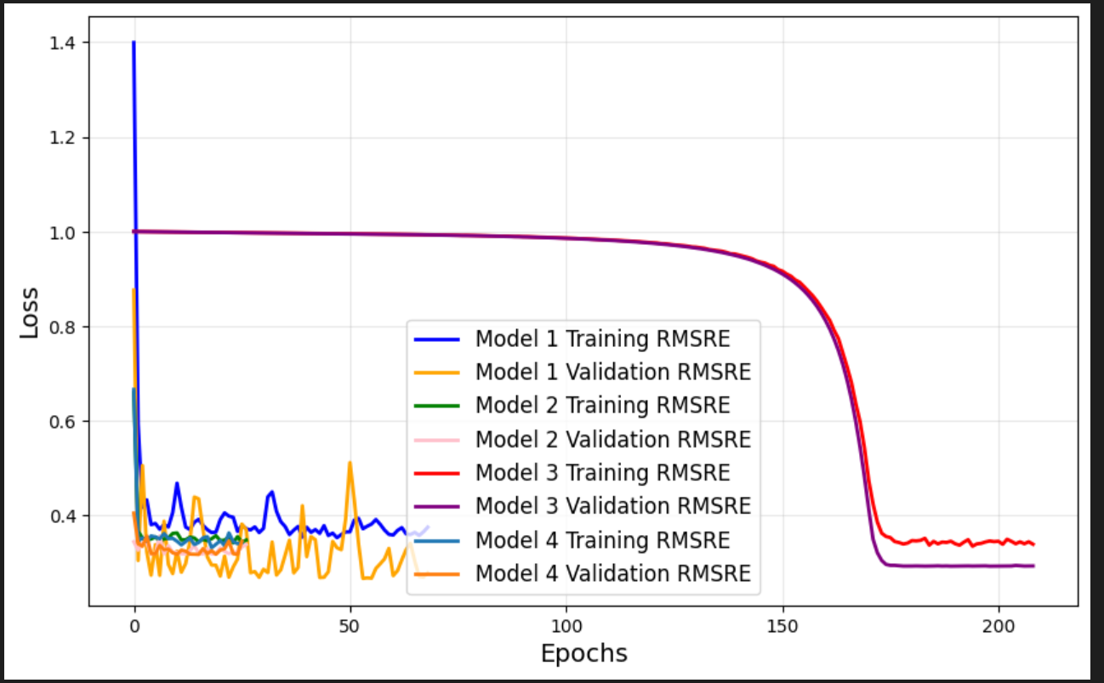
Results
Results :
Model1 : Normal Traditional(0.39) , Model2 : proposed arch(0.29), Model3 : LibAuc (0.34),Model4(0.36)

Slide 11
Discussion

Slide 12
Any Questions?
Thank You

